Slide 1

BITCOIN, TRANSACTIONS UTXO MODEL
Blockchain technologies, lecture 2
Notes:
NOTĂ:
Pentru a modifica imaginea de pe acest diapozitiv, selectați-o și ștergeți-o. Apoi faceți clic pe pictograma Imagini din substituent pentru a insera propria imagine.

Slide 2
Course overview
Blind signatures/zero-knowledge proofs
UTXO model
Transactions

Slide 3
Blind signatures
Bitcoin transactions’ history

Slide 4
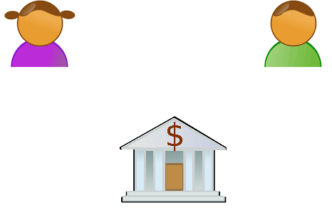
traditional payments
Single point of failure, not peer-to-peer.
Delayed or refused transactions.
Security and privacy issues.
Digital payments
Alice notifies Bob
Bob sends “token”
transfer 52MM to Bob
Bob check his balance
account | balance
Alice | $72,000,000
Bob | $0
account | balance
Alice | $20,000,000
Bob | $52,000,000

Slide 5
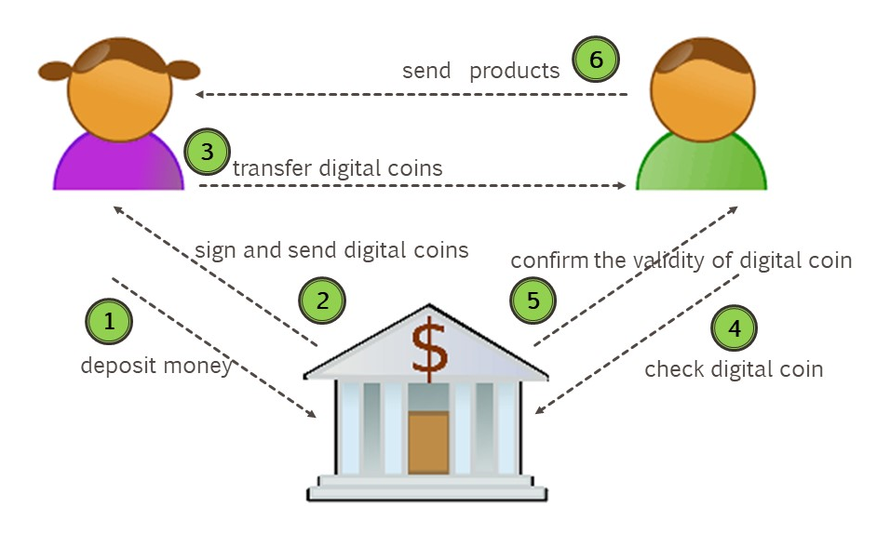

Slide 6
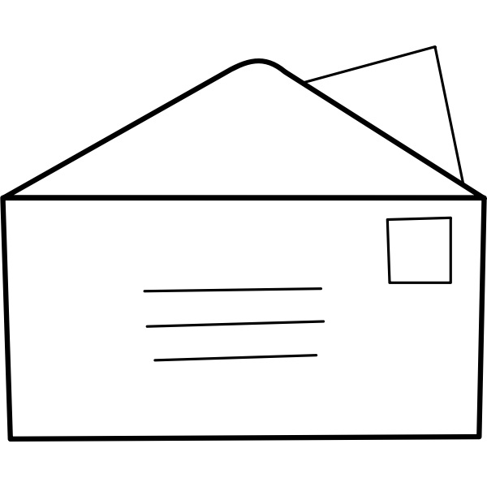
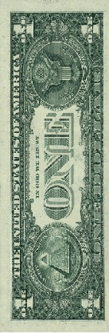

Chaum e-cash
Blind signatures (1983)
Alice sends a dollar to the bank and a blinded id, representing the digital coin she will be authorized to use in further transactions.
Imagine an encrypted envelope or carbon paper nested in an envelope with Alice’s address on it.
“blinded” envelope
with digital coin (id),
generated by Alice
Alice’s address

Slide 7
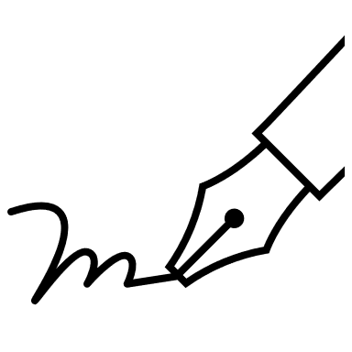
Chaum e-cash (1983)
Blind signatures
Bank is not able to dicover the id, it can only register how many coins are signed and sign Alice’s blinded id.
Bank has no record of Alices balance or transactions.
Alice can recognize/recover the id she generated.
Anyone can recognize the signature of the bank.
“blinded” envelope
with digital coin (id),
generated by Alice
with bank’s signature.
Alice’s address
coins
+1

Slide 8
digital coin (id),
generated by Alice
with bank’s signature.
Chaum e-cash
Blind signatures
Alice sends the signed, not blinded digital coin to Bob.
Bob’s address

Slide 9

Chaum e-cash
Blind signatures
Bob receives from Alice the id signed by the bank.
Bob recognize the signature of the bank.

Slide 10
Chaum e-cash
Blind signatures
Bobs claims 1$ in return for his digital coin.
Bank registers the id.
Bank doesn’t know that the id came from Alice and it has no information about the transaction.
Bank is able to detect double spending.
claimed ids
……
……

Slide 11
Chaum e-cash
Blind signatures
Peer-to-peer, but not decentralized.
bank signs all digital coins.
Advantages:
Privacy.
Digital payments.
Double spending detection.
transactions, transfer digital coins
signs digital coins

Slide 12
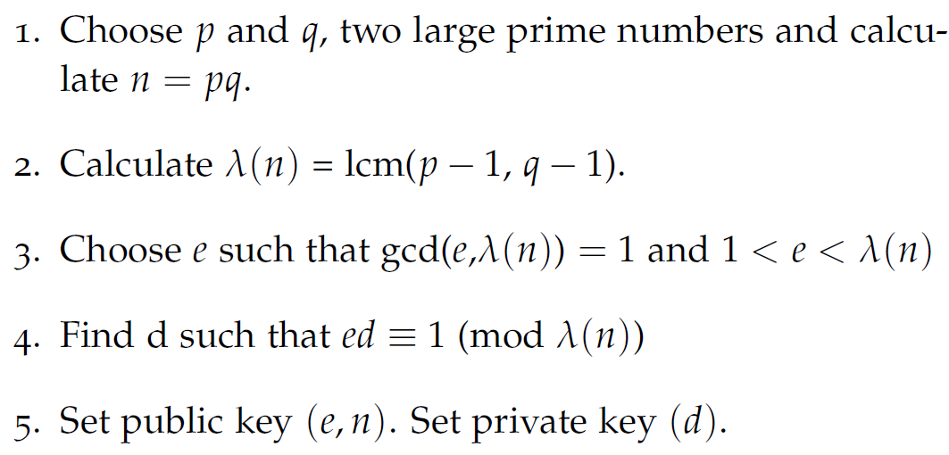
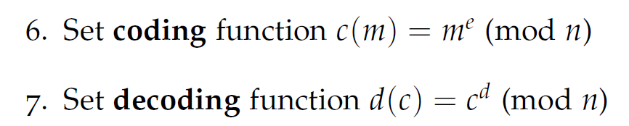
RSA
RSA: find three large positive integers e, d, and n, such that: knowing e and n (the public key), it can be computationally difficult to find d (the private key);
Anyone knowing the public key may send encoded messages that can be decoded only by someone knowing the private key, provided that (m^{e})^{d} = m (mod n).

Slide 13
Blind signatures
Signature of the Bank,
Bank can’t reveal any information about the id sent by Alice.
c is the blinded envelope.
Bank signs the envelope.
Alice is able to recover from the envelope the id with a valid signature of the bank.

Slide 14

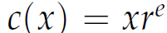

RSA - Blind signatures
Signature of the Bank,
Bank can’t reveal any information about the id sent by Alice.
c is the blinded envelope.
Bank signs the envelope.
Alice is able to recover from the envelope the id with a valid signature of the bank.
x is the token to be signed by the bank.

Slide 15
Signature of the Bank,
Bank can’t reveal any information about the id sent by Alice.
c is the blinded envelope.
Bank signs the envelope.
Alice is able to recover from the envelope the id with a valid signature of the bank.
x is the token to be signed by the bank.

Slide 16
UTXO unspent transactions output
Bitcoin transactions

Slide 17
UTXO
Public key – private key: Alice and Bob both keep a set of public/private key pairs. Alice can send coins that only Bob will be able to reuse, without the intervention of a third party.
Wallet: A wallet is associated with a pair of private/public keys. Each user pseudonymously may store a set of pairs of key.
UTXO: coins are placed in a wallet, being associated with a public key. Only the owner of the corresponding private key will be able to spend the UTXOs.

Slide 18
UTXO vs ACCOUNT model
Bitcoin does not memorize users’ balances, i.e. UTXO model does not memorize the sum of all unspent UTXOs owned by a wallet.
Ethereum has a state transition model. In each state of the blockchain, an account has a balance. A transactions is a state transition, i.e after a transaction the account balance of the sender and the account balance of the receiver are changed.

Slide 19
Bitcoin UTXO model
Bob is selling a product
price 27
Alice
10 UTXO
15 UTXO
7 UTXO
Bob

Slide 20
Bitcoin UTXO model
multiple inputs
coins have different values
a coin may be spent only once
Alice
10 UTXO
15 UTXO
7 UTXO
transaction
10 UTXO
15 UTXO
2 UTXO
3 UTXO
Bob

Slide 21
Bitcoin UTXO model
multiple outputs
some outputs are placed
in the sender’s wallet as change
some outputs represent fees
Alice
10 UTXO
15 UTXO
7 UTXO
transaction
10 UTXO to Bob
15 UTXO to Bob
2 UTXO to Bob
3 UTXO to Alice
2 fee to miner
Bob
10 UTXO
15 UTXO
2 UTXO

Slide 22
Bitcoin UTXO model
Bitcoin Balance = sum of the unspent transaction outputs “owned”, not memorized!
pay with previous unspent transaction outputs
“change” is considered unspent transaction output locked to payer himself
no double spending:
total input of a transaction = equal total output + fees
in a transaction coins are consumed and replaced with new ones.

Slide 23
Bitcoin UTXO model
New coins are also created by mining
transactions without input: Coinbase transaction -- miners reward!
Coinbase transaction is the first transaction in a block.
The reward halves each four year (after 210,000). Since 2020 block reward is 6.25BTC

Slide 24
UTXO set
Set of UTXO: the set of all UTXOs is replicated on all full nodes but only the rightful owners are able to use them in transactions.
UTXO are memorize in a Level DB database: Chainstate.
Chainstate is the set of all unspent transactions as they appear up to the last block added in the blockchain.
Chainstate is redundant as it can be reconstructed from the date stored in the blockchain, but this would be extremely slow and inefficient

Slide 25
TRANSACTIONS
Bitcoin transactions

Slide 26
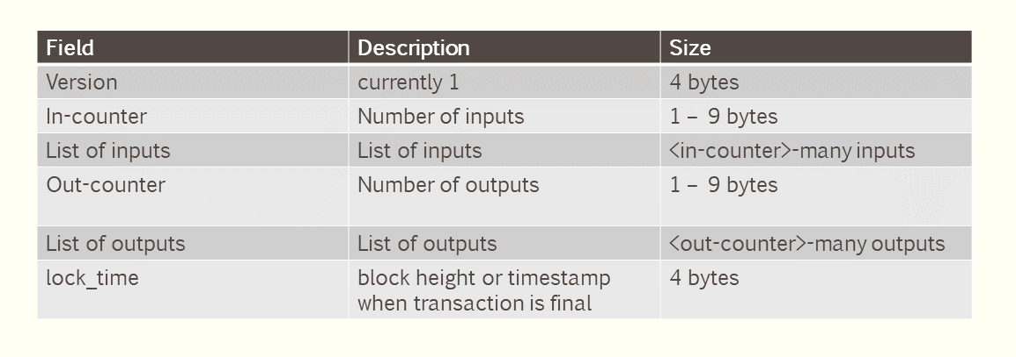
lock_time field -- transaction will not be confirmed until a specific timestamp
or transaction will be confirmed after 6 confirmations

Slide 27
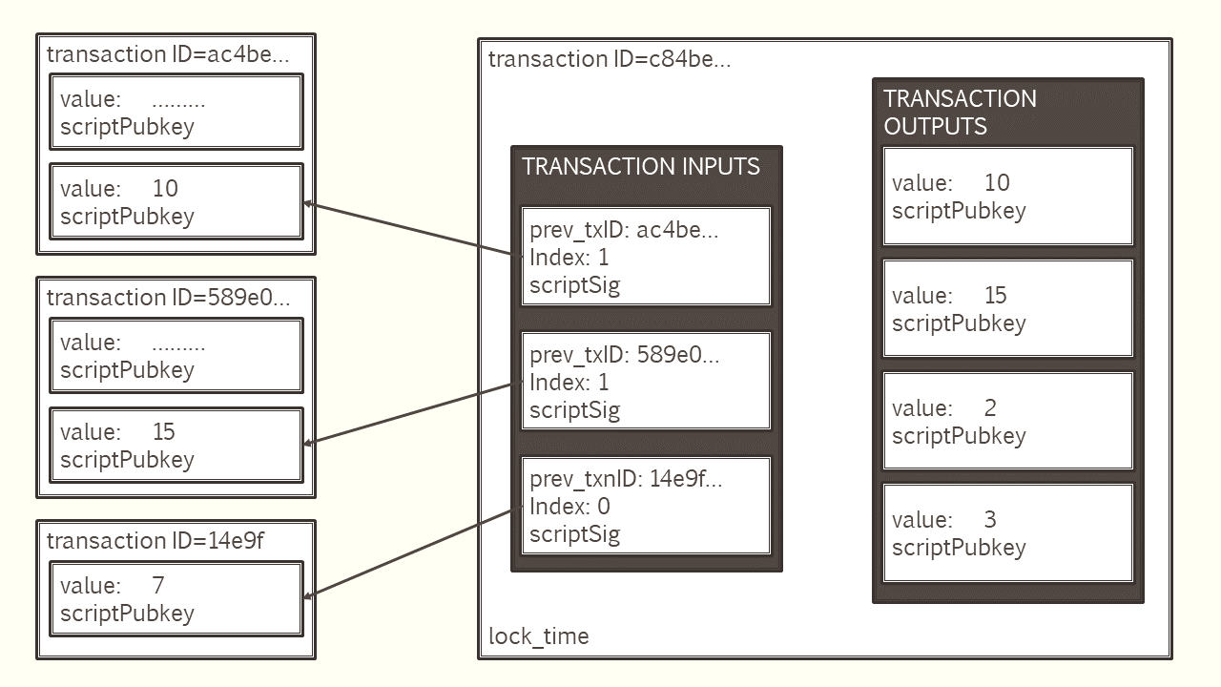

Slide 28
Transactions – Locking script
ECDSA signature => public/private key
public key => bitcoin address
Bitcoin address => scriptPubKey
Challenge to users that want to claim a specific output. Only the owner of the UTXO should be able the unlock the UTXO providing the unlocking script scriptSig.
Alice signs the transaction and sends the output to public key.
scriptPubKey
public key
signature

Slide 29
Transactions -- Unlocking Script
scriptSig
include receiver public key hash
instructions (op_codes) to verify public key
scriptSig
OP_DUP
OP_HASH160
OP_EQUALVERIFY
OP_CHECKSIG

Slide 30
Bitcoin UTXO model
P2PKH pay to public key hash
scriptPubKey
public Key
signature
scriptSig
OP_DUP
OP_HASH160
OP_EQUALVERIFY
OP_CHECKSIG

Slide 31
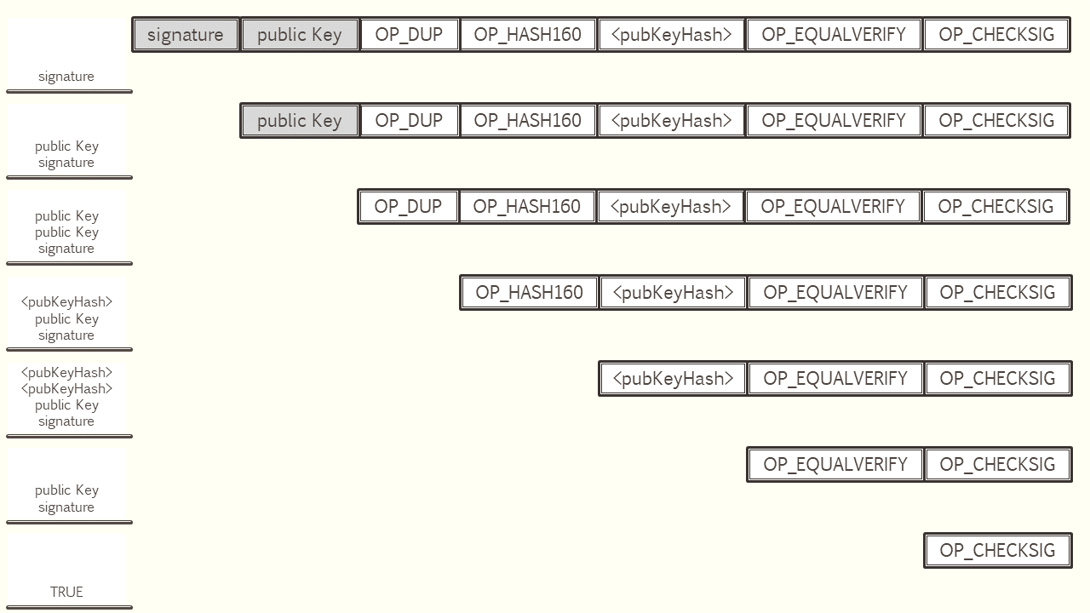

Slide 32
UTXO model
Simple
Verify transactions in parallel,
a UTXO affected by only one transaction
Privacy (wallets)
Limited smart contract capabilities

